Slide 1
Trigonometry Basics
Right Triangle Trigonometry

Slide 2
What is Trigonometry?
TRIGONOMETRY
Greek Words
THREE
SIDES
(METRON)- MEASURE
Trigonometry is the study of relationships between the sides and angles of a triangle.

Slide 3
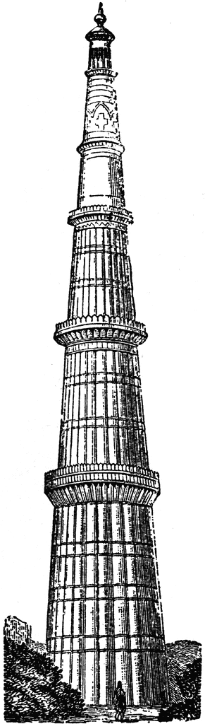

Why do we need trigonometry?
Suppose you visit Qutub Minar.
The height of Qutub Minar can be found out without actually measuring it, using trigonometry.
QUTUB MINAR
YOU

Slide 4
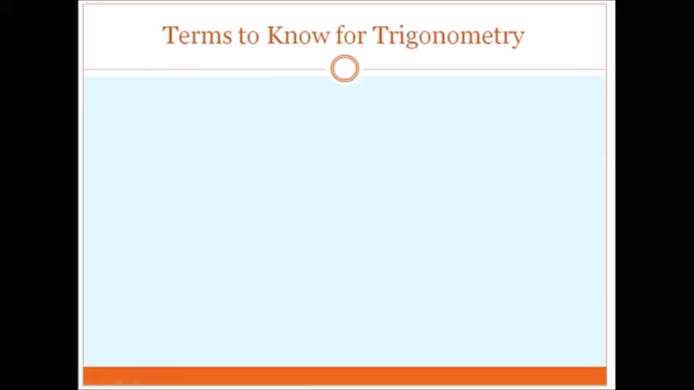

Slide 5
FOR “A” AS REFERENCE ANGLE
C
HYPOTENUSE
(h)
OPPOSITE
(o)
REFERENCE ANGLE
A
B
ADJACENT
(a)

Slide 6
FOR “CA” AS REFERENCE ANGLE
C
REFERENCE ANGLE
Hypotenuse
(h)
ADJACENT
(a)
A
B
OPPOSITE
(O)
The position of sides changes when you consider ∠C in place of ∠A.

Slide 7
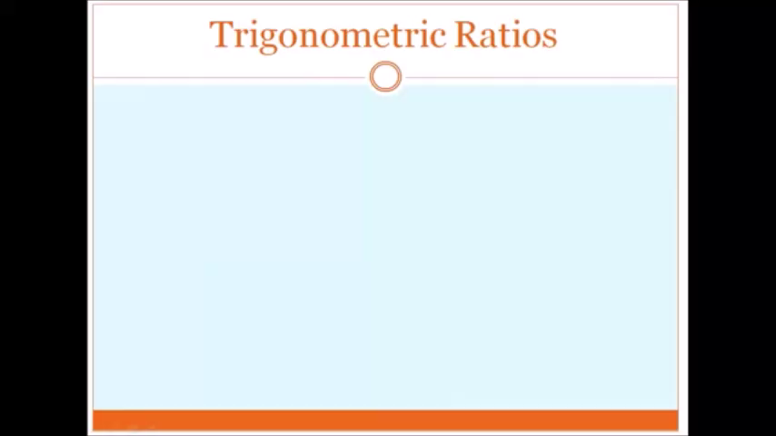

Slide 8
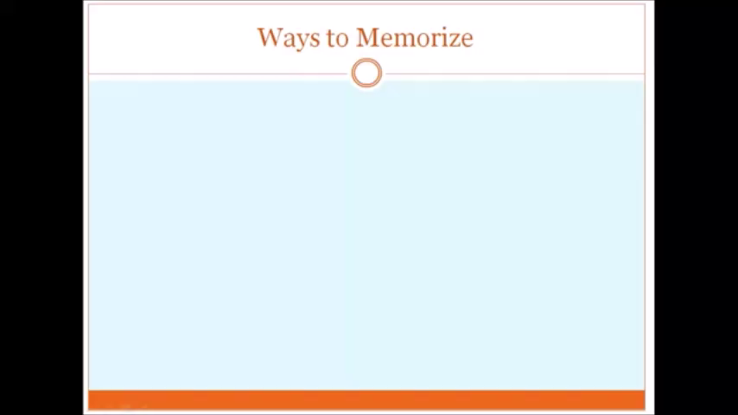

Slide 9


Trigonometric ratios
How are we going to remember all these ratios??
SOHCAHTOA!!

Slide 10
Trigonometric ratios
There’s another way to remember the trigonometric ratios, as well.
Some People Have Curly Brown Hair Through Proper Brushing
S-Sine
P-Perpendicular
H-Hypotenuse
C-Cosine
B-Base
H-Hypotenuse
T-Tangent
P-Perpendicular
B-Base
C
HYPOTENUSE
Side opposite to ∠A
PERPENDICULAR
A
B
Side Adjacent to ∠A
BASE

Slide 11
MORE TRIGONOMETRIC RATIOS
RECIPROCAL RATIOS
QUOTIENT RATIOS

Slide 12
There are three more trig functions. They are called the reciprocal functions because they are reciprocals of the first three functions.
Oh yeah, this means to flip the fraction over.
Best way to remember these is learn which is reciprocal of which and flip them.

Slide 13
RECIPROCAL RATIOS

Slide 14
QUOTIENT IDENTITIES

Slide 15
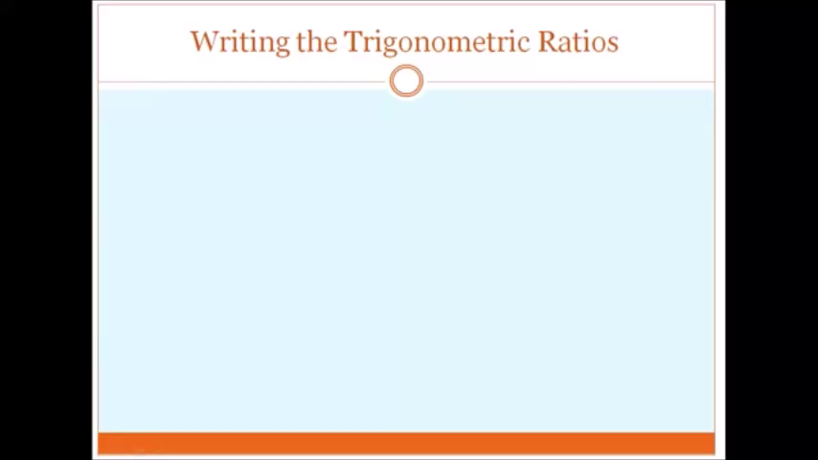

Slide 16
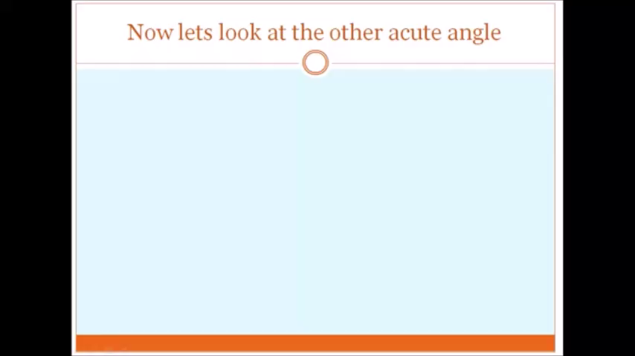

Slide 17


